Slide 1
SID VIP
By: Michael Muller
Austin Nguyen
Joshua Kulwicki
Niranjan Chennasamudram Balaji
Notes:
Hello I’m whoever is introducing us
Today we will be presenting our class project, SID VIP

Slide 2
Overview
Problem Statement/Solution
Hardware View
Top Level Components
Acoustic
Haptic
Sensor
Display
Wifi
Demo
Questions
Notes:
Throughout this presentation we will be going over our inspiration behind the project, hardware, the implementation of each component, and finally ending with a live demonstration

Slide 3
Problem Statement
Technology advances can be expanded beyond “convenience”
Visual impairment assistance devices are expensive
Between $500 - $4,000 depending on cane or shoe device
Technology is cheaper and more available
Notes:
As we’ve discussed in this class, the advances in technology over the last 20 years alone have been substantial. We have the capability to design and develop cost effective and available solutions that extend beyond comfort.
We decided to use this ease of access to, and understanding of technology to create a product that would provide much more than a luxury to VIP’s (Visually impaired persons)
Devices targeted for this disability can cost between $500 and $4,000.

Slide 4


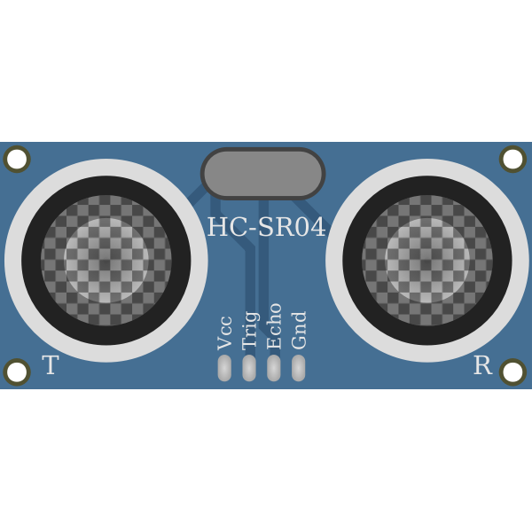

Solution
Fusion between haptic and acoustic feedback
Identifiably different feedback patterns for objects
Low cost, low power
Notes:
Our solution, we call it SIDS VIP
With a combination of both haptic and acoustic feedback, we created a system that would alert it’s user of nearby objects
The varied feedback patterns help the user identify object distance similar to a vehicle with a rear view camera
While the Nexys board was relatively expensive, this could be done for significantly less with specially designed hardware.
Making this solution low cost and given the nature of the components, low power as well.

Slide 5
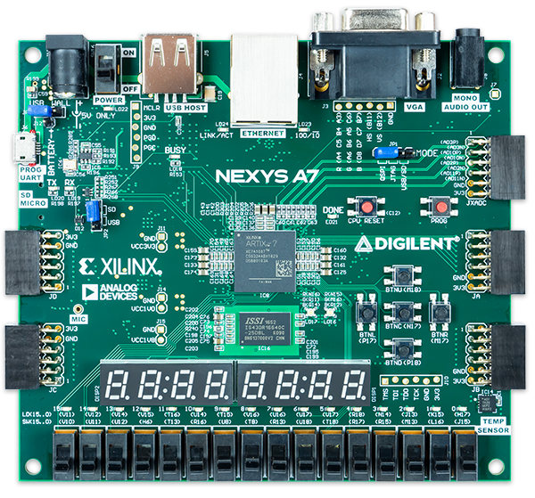

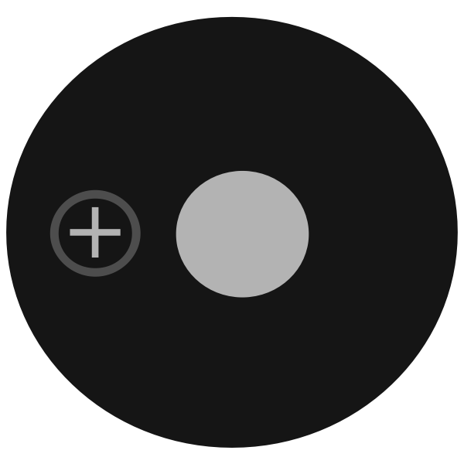
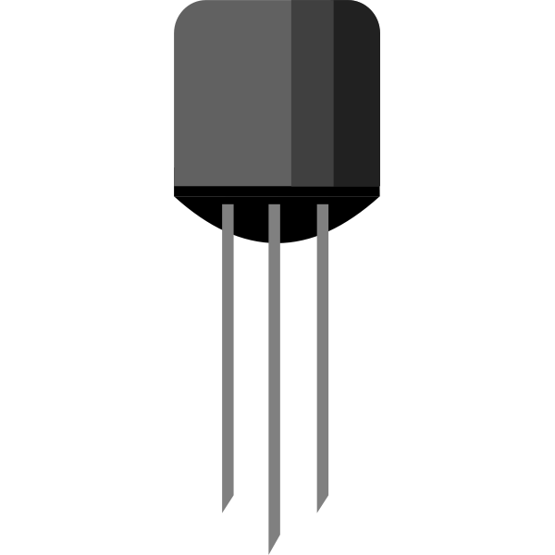
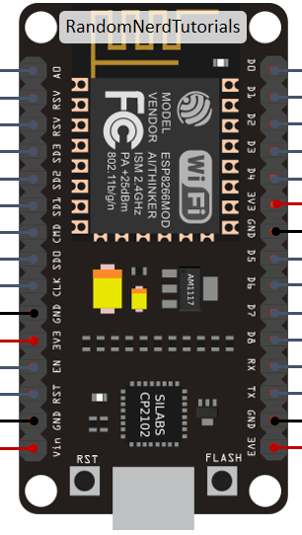
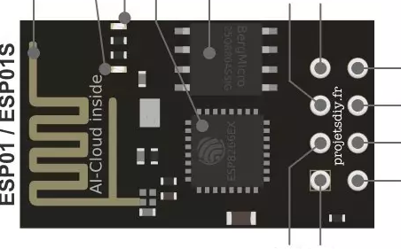

Hardware Design
3.3V vibrating micro servo
7 Segment Display
ESP8266-01 Wifi module (client)
ESP8266 Wifi module with Buzzer (server)
HC SR04-P Ultrasonic Sensor
Notes:
Our initial top level hardware design used the following components 2x esp wifi modules (a client and server)
1x Ultrasonic sensor
1x Buzzer
1x Servo motor
And the Nexys A7 board
The Ultrasonic sensor will detect objects, based on the object's distance, we will send feedback requests to the servo and esp module.

Slide 6
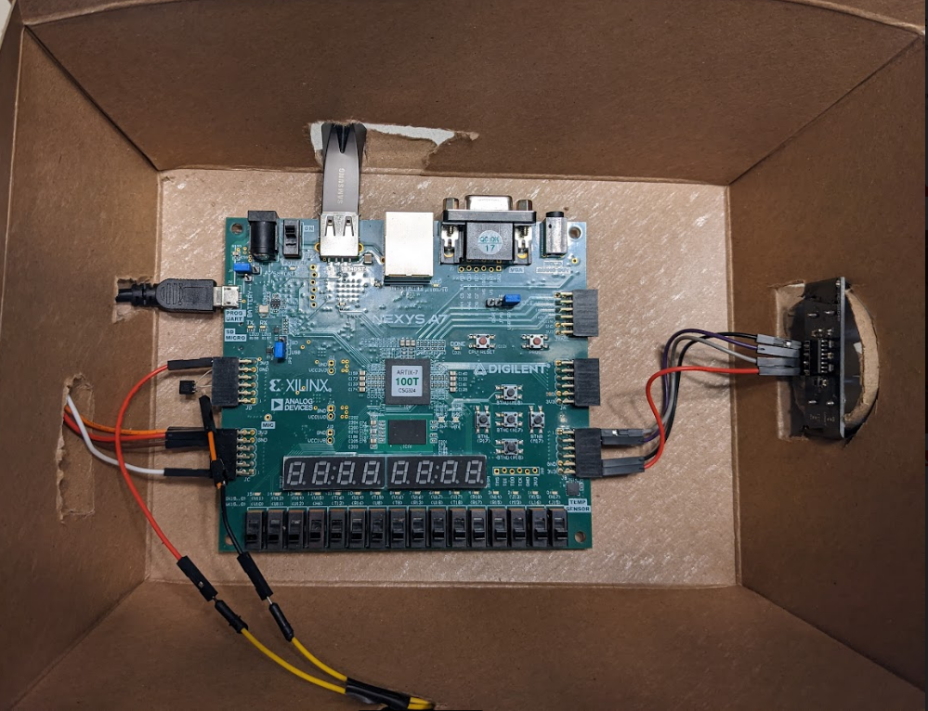
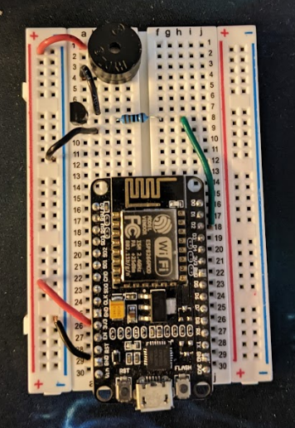
Hardware Implementation
Buzzer
Servo module
(SID controller)
ESP Server Module (Wifi)
Ultrasonic Sensor
Uart to ESP module (Wifi)
(Handheld Device)
Notes:
Here is what the physical implementation of the hardware looks like
***(Wait a few seconds before continuing)****

Slide 7
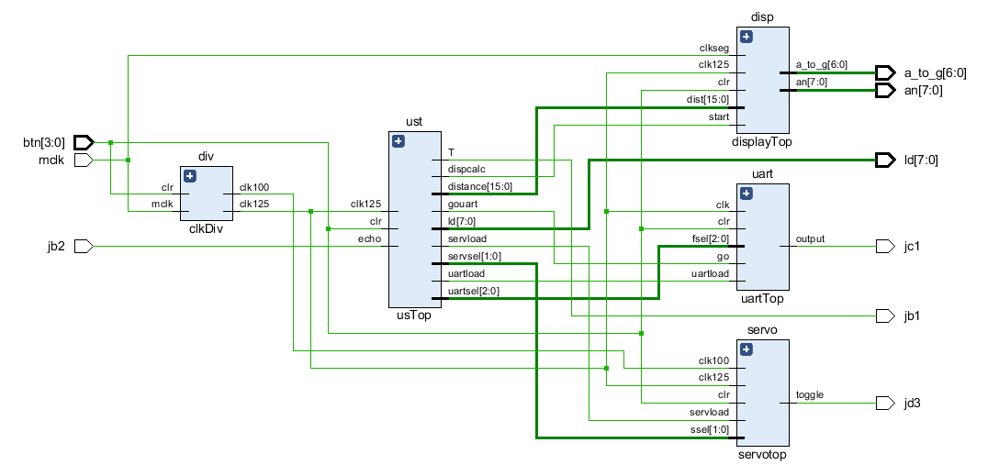
Schematic
Notes:
As well as our design schematic, which can be referenced to get a bigger picture of who each component is controlled.

Slide 8
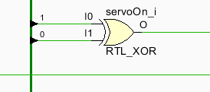
Servo component
Servo Component uses both 12.5 Mhz and 100 Khz clock
Servo duty cycle component runs on 100 Khz clock
Object distance ranges for servo
“Close” - range: 0 - 39 cm
“Near” - range: 40 - 59 cm
Priority of object in case of conflict
1) Close
2) Near
The servo duty cycle based on object distance
100% at close (full 500 ms)
50% at near (250 ms intervals)
Figure 1: XOR triggers Haptic Feedback
Notes:
The servo component is unique because it contains two separate clocks and doesn’t require a go signal from the UST controller
The 12.5 Mhz clock is used to run the register which reads from the UST (ultrasonic top) controller, this ensures no missed start calls to the module
And then the counter, which controls the duty cycle, runs on a 100Khz clock. This was done to simplify the duty cycle calculation.
Objects that trigger haptic feedback must be classified as near or close, denoted by the thresholds above
In case of overflow or error in the system, if an object is classified as both close and near, we will assume the “close” classification
Each Duty cycle runs for a max of 500 ms. 50%, or 250 ms intervals, are used for near objects. While a constant vibration, 100% duty cycle, is used for “Close” objects.
The servo component will receive the object classifications from the UST controller and on the following cycle, will use an “XOR” gate checking if either a close or near object is detected, which triggers vibration

Slide 9
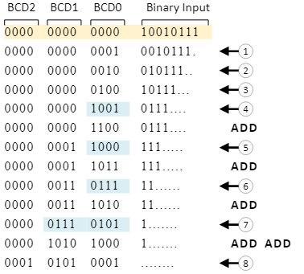
Display Component
Stores distance from Ultrasonic sensor
Performs Double Dabble Algorithm
Convert from binary to Binary Decimal (Hex -> Decimal)
If a nibble contains > 5, then add 3 and shift
Repeat until binary has been fully shifted
Post Double Dabble, Decimal is displayed
Distance in Cm is displayed
Max distance displayable 400cm
Figure 2: Double Dabble Steps
Notes:
The display component will store the most recently calculated distance from the UST controller (Ultrasonic top)
We then convert the Hex value into Binary Coded Decimal (BCD) which uses the Double Dabble Algorithm.
Double dabble looks at each nibble of the BCD and determines if it’s value is greater than 5. If it is, we add 3 and then after checking each nibble we shift the current binary value left and repeat.
As seen in figure 2
When we are not currently calculating the Binary Coded Decimal, we are outputting the previously stored BCD to the display.
The US component will control when the register for the display is loaded and when it can begin calculating the BCD (Binary Coded Decimal).
This component was mainly created for debugging purposes and as a proof of concept for our object thresholds.

Slide 10
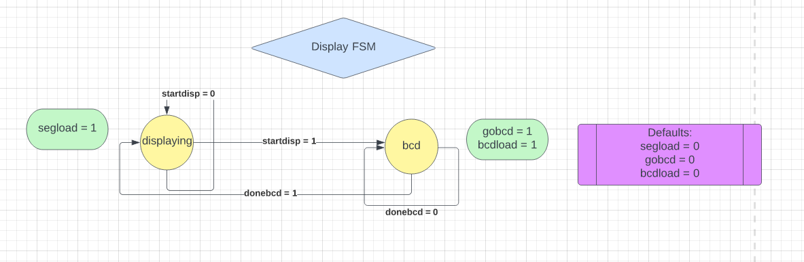
Display FSM
Notes:
Here is what the Display component State machine looks like. As mentioned, while not calculating the BCD, we are ‘displaying’ the output. We then start converting from Binary to BCD when the US controller sets the “StartDisp” signal to 1. Once the BCD is finished, we load the segment register and display

Slide 11
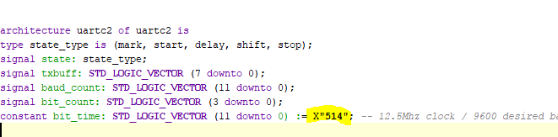
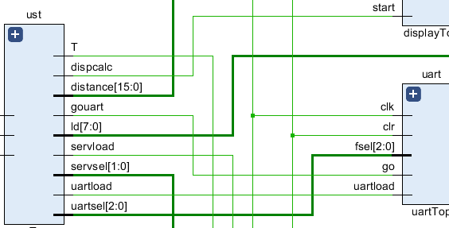
UART Component
Receives object classification each measurement as 3 bit signal
Far, near, and close classes are concatenated respectively
A mux selector determines byte to be sent
“001” - X”0A”
“010” - X”0B”
“100” - X”0C”
Default - X”0D”
9600 baud rate was selected arbitrarily
UltraSonic controller sends “gouart” signal
Figure 3: UART 9600 Baud
Figure 4: UST to UART Top
Notes:
The uart component takes an object from the Ultra sonic top component and determines which byte classification to send to the esp wifi module.
We receives a 3 bit signal, which is the object classifications concatenated together. (Far, near and close respectively)
From there, a mux is used to select the byte to send to the esp module
We’ve selected a 9600 baud rate which aligns with the ESP baud rate, as seen figure 3
The uart begins transmitting it’s byte of data when the Ultrasonic sensor controller has finished classifying the object distance denoted by the “gouart” signal in figure 4

Slide 12
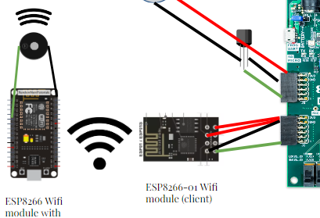
ESP Communication
ESP modules communicate using UDP packets
On board ESP is client
Handheld device hosts server (Access point)
Handheld device only updates on new data
Chiming is duty based
Intervals are completed for smooth toggling
Notes:
Upon power on, the on board ESP wifi module will connect to the server hosted by the hand held device. Which must be on as well obviously
Once the on board ESP module receives a new byte of information through uart, it will send the byte over wifi via the User datagram protocol or UDP, to the hand held device which will determine chime intervals.
The chime function only updates if new data is received from the board, this will limit the amount of udp packets sent over wifi

Slide 13
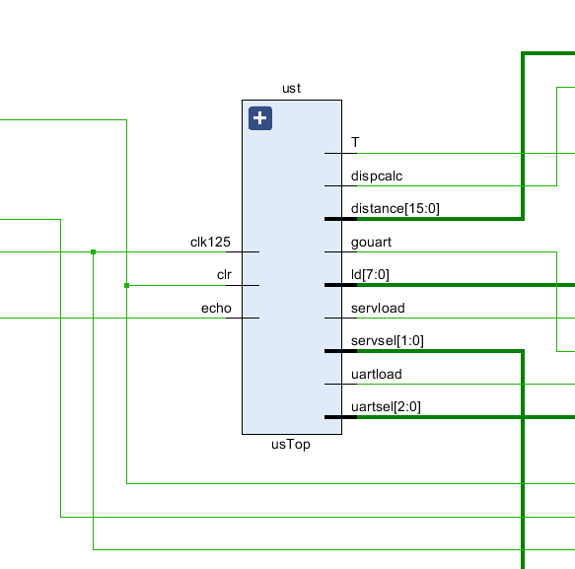
Ultrasonic Top Component
Drives the entire system
Ultrasonic sensor
Feedback duties
Display
Loads component registers
Echo is read in from jb2
Connected to sensor echo pin
T is output to Jb1
Connected to sensor trigger pin
Figure 5: UST component
Notes:
We wanted to save the main controller for last so we could go over how each component is used
The UST component drives the entire system as the main FSM.
The UST uses the on board PMOD pins jb1 and jb2 for the ultrasonic sensors trigger and echo pin respectively
This component mainly sends the go signals for each component as well as loads the component registers

Slide 14
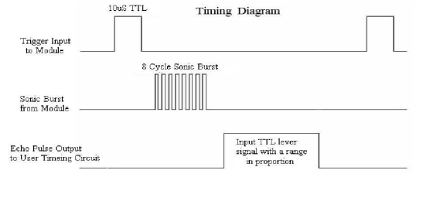
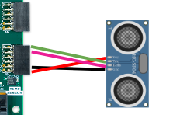
Ultrasonic Sensor
Trigger pin requires at least 10 us high
8 pulses at 40 Khz are output
Echo pin remains high until pulses received
60 ms recommended measurement time
Figure 6: Sparkfun HCSR04 datasheet
Notes:
The ultrasonic sensor we chose was the Hc-SR04 P a lower power version which can run on 3.3v instead of 5
To drive sensor, we need to pull the trigger pin high for at least 10 us, at which point it will send out 8 pulses at 40Khz
Once the pulses have been sent out, the echo pin, read in on port Jd1 on the board, will go high until all pulses have been received. The echo pin will then go low and we use that time to determine an object’s distance.
Each measurement will take a total of 60ms which accounts for sensor time out

Slide 15
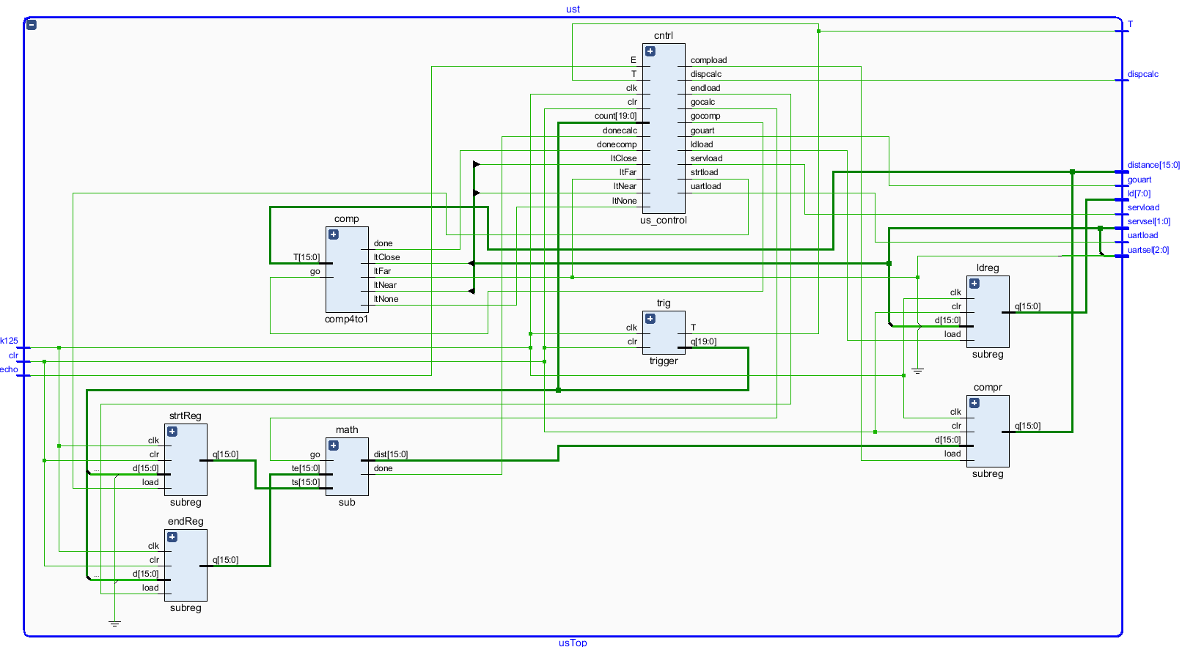
Ultrasonic Top Component (Design)
Controller for the entire system
Determines object classification
Trigger component Drives sensor
Math component and 2 regs calculates distance
Notes:
Here’s a look at the UST design
Here we’ve got the main controller of the UST. This drives the Sensor’s trigger counter as seen here, followed by the calculation component, and finally, the object classifier which compares distances to predetermined thresholds.
Once the comparator has finished, the FSM will be put in a done state until the next measurement from the sensor is take. On the far left you can see the registers that store the comparator result for the other components.

Slide 16
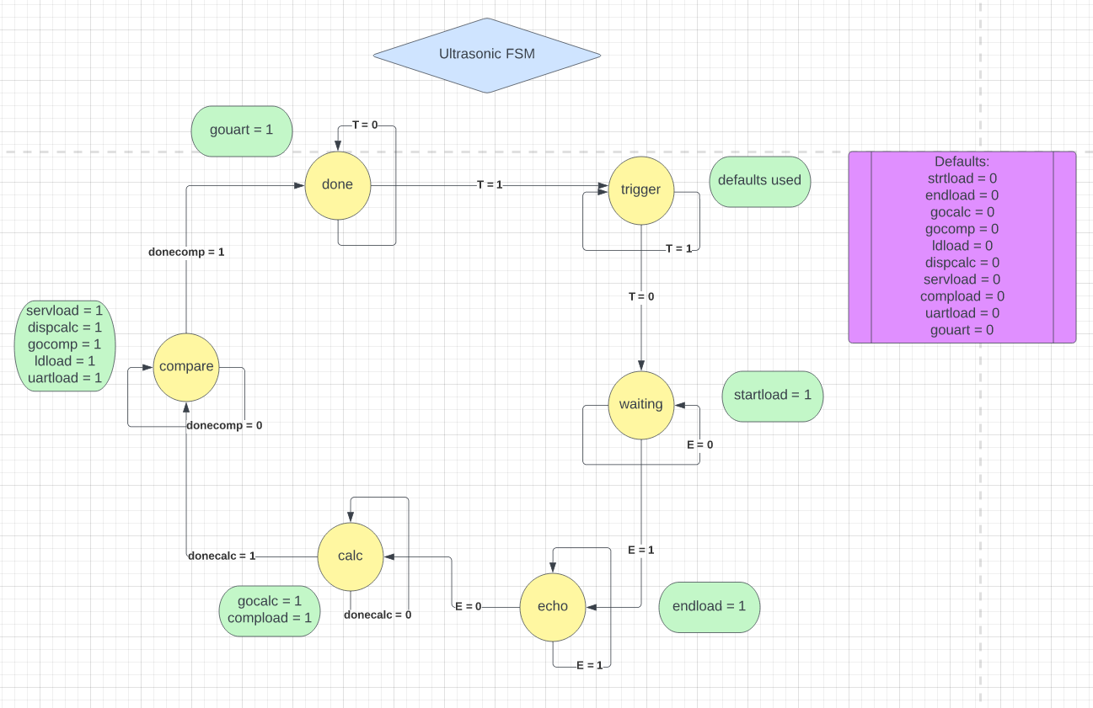
UST State Machine
Sensor uses first 3 states
The servo and display component function during comparing
The Uart component begins transmitting during done state
Notes:
We default to the done state on the first cycle on. (Uart defaults to no object)
The first three states are related to the sensor pins.
After the measurement time is recorded, we begin calculating distance
Afterwards we compare against the defined thresholds and allow the display to calculate and load the led’s
Once we finish comparing, the most recent data is stored in the relevant registers and the measurement continues to wait in the done state.
At 12.5 Mhz, we only require about 1800 us to complete a state machine cycle.

Slide 17
SID DEMO

Slide 18
References
UltraSonic sensor data sheet
https://cdn.sparkfun.com/datasheets/Sensors/Proximity/HCSR04.pdf
Esp Pinouts
ESP 01
https://www.google.com/url?sa=i&url=https%3A%2F%2Fdiyprojects.io%2Fesp01-get-started-arduino-platformio-ide-module-choose-pinout%2F&psig=AOvVaw3sGhat-j9wfeYdJ7MdyPvO&ust=1670458920578000&source=images&cd=vfe&ved=0CA4QjRxqFwoTCLisvMae5vsCFQAAAAAdAAAAABAE
Esp Generic
https://www.google.com/url?sa=i&url=https%3A%2F%2Frandomnerdtutorials.com%2Fesp8266-pinout-reference-gpios%2F&psig=AOvVaw3ZKGeVCL1qLtCFMhIV9X1k&ust=1670459105422000&source=images&cd=vfe&ved=0CA4QjRxqFwoTCKDRzp6f5vsCFQAAAAAdAAAAABAE
ESP Server/Client
https://randomnerdtutorials.com/esp8266-web-server/
https://randomnerdtutorials.com/esp8266-nodemcu-client-server-wi-fi/
Double Dabble
https://www.realdigital.org/doc/6dae6583570fd816d1d675b93578203d
https://www.realdigital.org/img/05824566b6b8b7e5fb9da9451a8018a4.svg (Figure 1)
Double Dabble Creator Link/repo (GEEK)
https://www.youtube.com/watch?v=Q-hOCVVd7Lk
https://github.com/josh-macfie/VerilogDoubleDabble/blob/master/BCDConvert.v

